Slide 1
Model for IOTA MCQs

Slide 2
Which of these statements about ….is correct according to the IOTA terms and definitions?
A: ……
B: …… …….
C: ……
D: ……
E: All of the above

Slide 3
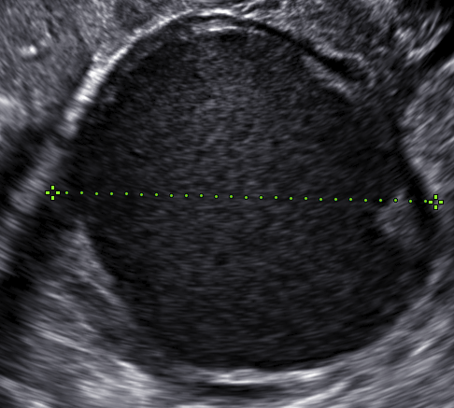
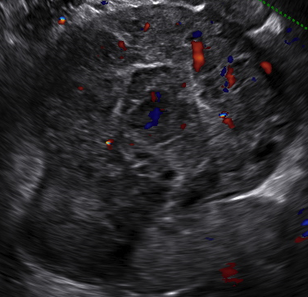
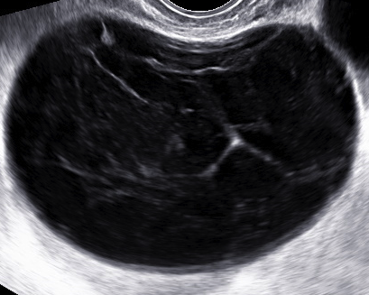
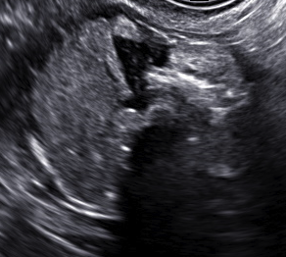
In which of these cases would you expect ………?
A: a
B: b
C: c
D: d
a
b
c
d

Slide 4
How is this tumour classified using the simple rules?
Image or video-clip
A: Benign
B: Malignant
C: Not classifiable

